Slide 1

Probabilistic Reasoning - Final Presentation
PINN vs Finite Difference on Singular Three-Point Boundary Value Problems
Presented by: (Batch - 22)
Sri Vardhan Parachuru (Group Leader)
Team members:
  Sushanth Allampati
  Bhaskar Teja Gopu
  Navadeep Pantulwar
  Gopi Mahesh Konduru
  Sai Harshith Rekandar
Guided by: Dr. V.M.K. Prasad Goura
github llink
https://github.com/pantulwarnavadeep/pinn-vs-fdm

Slide 2

Reference Paper & Where We Started
Reference Research & Starting Point
  Reference work: Nadeem et al., Ain Shams Engineering Journal, 2026
  The paper investigates singular three-point boundary value problems (TPS-BVPs).
  Four PINN approaches were studied:
  Standard PINN
  PINN + L1 regularization
  PINN + L2 regularization
  Adaptive PINN (A-PINN)
What the paper did
  Compared PINN predictions with the exact/analytical solution.
  Used a single training seed for each configuration.
What we questioned
  Are the reported PINN results stable across different initializations, and how do they compare with a classical numerical solver?

Slide 3
Research Gap & Our Contribution
Research Gap → Our Extension
REFERENCE PAPER
Our Research Questions
OUR EXTENSION
Key Categories
1. Multi-seed experiment
  10 random seeds
  Seeds 0–9
2. Larger controlled experiment
  10,000 epochs
  120 PINN training runs
Limitations identified
  One random seed per configuration
  No classical numerical baseline
  No direct PINN vs FDM comparison
  Limited evidence about initialization sensitivity
3. Classical baseline
  Finite Difference Method
  N = 50, 100, 200, 400
4. Direct comparison
  Accuracy
  RMSE
  Computational time
  Grid convergence

Slide 4


Architecture: PINN Framework for Singular Three-Point BVPs + Finite-Difference Extension
Singular TPS-BVP
Ex 3.1: y = sin πt
Ex 3.2: y = sinh t
Ex 3.3: nonlinear, y = sinh t
Singular coeffs:
1/t, 1/[t(1−t)]
Three-point BC:
y(0)=α
y(1)=ε·y(θ)+β
LANE 1 · PINN (paper framework + our modifications)
Stabilized residual
× t or × t(1−t)
(equivalent on (0,1))
Collocation points
N = 500
in [1e-3, 1−1e-3]
(paper: 1500)
MLP
1→20→20→20→1
tanh, PyTorch,
CUDA / MPS / CPU
Autograd
ŷ → ŷ′ → ŷ″
Loss terms
L_f : residual MSE
L_bc : t = 0, θ, 1
Training variants (λ = 1e-3)
Adam
lr 1e-3
10,000 epochs
10 seeds (0–9)
checkpoint + resume
Evaluate vs exact
1000 test pts
RMSE, MAE, MAPE, R²,
R, rSD, NSE, RE
Aggregate
mean ± std,
best / worst seed
→ best PINN
Standard
L_f+L_bc
+ L1
λ·Σ|W|
+ L2
λ·ΣW²
A-PINN
adaptive ω
PINN vs FD comparison
RMSE, RE
wall-clock time
PINN/FD ratios
(best PINN vs FD, N=400)
12 configurations (3 examples × 4 variants) × 10 seeds = 120 PINN runs
LANE 2 · Finite-difference baseline (new)
Grid
N = 400, h = 1/N
θ on a grid node
Discretize
central differences,
ODE at interior nodes
BC
Sparse Newton
analytic Jacobian,
backtracking, tol 1e-10
Evaluate
same metrics vs exact
+ N = 50…400 study
Final interpretation
FD is strong on smooth 1-D
problems; PINN trade-offs
discussed honestly
LANE 3 · Auxiliary paper-style sweeps (1 seed × 3000 epochs)
Depth sweep: 3, 6, 9, 12, 15 layers
Activation: tanh, sigmoid, ReLU, SeLU
Recreate paper Figs 1–12
From the paper
Our extension / modification
Shared / auxiliary
Paper: TensorFlow, 1500 collocation points, 3000-epoch figures, Standard / L1 / L2 / A-PINN on 3 TPS-BVP benchmarks, depth & activation sweeps.
Extension: stabilized residual, 10-seed × 10k-epoch statistics, finite-difference baseline with grid convergence, direct PINN-vs-numerical comparison.

Slide 5

Problem Formulation & Benchmarks
Singular Three-Point Boundary Value Problems
A singular three-point boundary value problem (BVP) is a differential equation together with boundary conditions specified at three distinct points, where the equation or its coefficients become undefined (singular) at one or more points in the domain (such as t = 0 or t = 1).
Example 3.1
Trigonometric problem
Exact solution:
y(t) = sin(πt)
Singularity:
  t = 0
Example 3.2
Hyperbolic problem
Exact solution:
y(t) = sinh(t)
Singularities:
  t = 0
  t = 1
Example 3.3
Nonlinear TPS-BVP
Exact solution:
  y(t) = sinh(t)

Slide 6
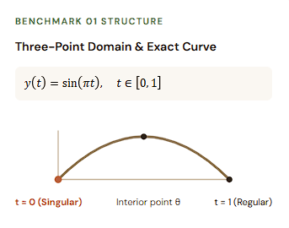
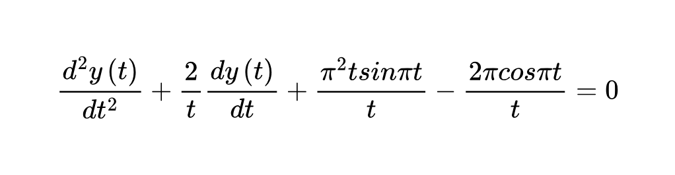



THE FIRST PROBLEM
SING-THREE POINT BOUND-PROBLEMS
Example 3.1
Governing Singular ODE (Trigonometric TPS-BVP)
Benchmark Specifications
  Exact Analytical Solution:
on
  Endpoint Singularity: Coefficient diverges at origin t = 0
  Three-Point Boundary: Conditions enforced at t = 0, interior point θ, and t = 1
  Difficulty Level: Easiest benchmark — linear trigonometric ODE
6

Slide 7
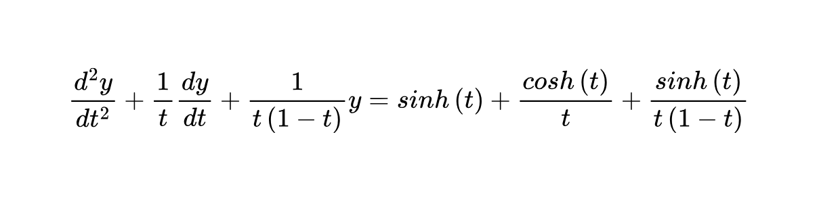
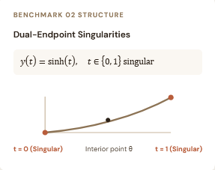


THE SECOND PROBLEM
SING-THREE POINT BOUND-PROBLEMS
Example 3.2
Governing Singular ODE (Hyperbolic TPS-BVP)
Benchmark Specifications
  Exact Analytical Solution:
on
  Dual Singularities: Term diverges at both t = 0 and t = 1
  Three-Point Boundary: Conditions enforced at t = 0, interior point θ, and t = 1
  Difficulty Level: Intermediate — adds second endpoint singularity
7

Slide 8
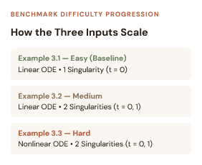
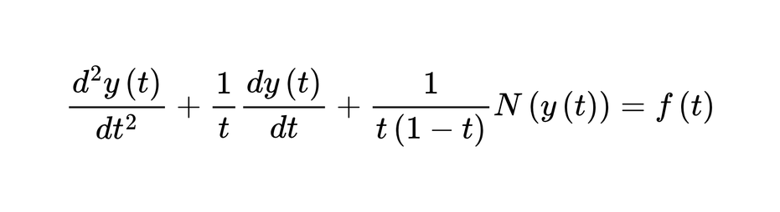
THE THIRD PROBLEM
SING-THREE POINT BOUND-PROBLEMS
SING-THREE POINT BOUND-PROBLEMS
Example 3.3
Governing Singular ODE (Non - Linear TPS-BVP)
Benchmark Specifications
  Exact Analytical Solution:
on
  Dual Singularities: Singular coefficients at both endpoints t = 0 and t = 1
  Three-Point Boundary: Conditions enforced at t = 0, interior point θ, and t = 1
  Difficulty Level: Hardest benchmark — nonlinear differential equation
  Nonlinear Term: N(y(t)) couples state variable with singular factor
8

Slide 9








Configurations
Four PINN Configurations Studied
MODEL 01 (EQ. 6–8)
Standard PINN
MODEL 02 (EQ. 12–13)
PINN + L1 Reg.
MODEL 03 (EQ. 14–15)
PINN + L2 Reg.
MODEL 04 (EQ. 10–11)
Adaptive PINN
Penalty factor
Ridge penalty
Minimizes unweighted ODE residual MSE plus 3-point boundary condition loss
Drives redundant weights toward zero to induce sparsity and reduce complexity.
Penalizes large squared weights for smooth convergence near singular regions.
Dynamically re-weights residual and boundary losses via gradient-norm balancing.
NEURAL NETWORK FLOW: Input t → [20 Neurons — tanh] → [20 Neurons — tanh] → [20 Neurons — tanh] → Output ŷ
9

Slide 10
Training setup
PINN Configurations & Training Setup
1. Network Depth & Width
3 hidden layers × 20 tanh neurons ([20, 20, 20]); paper also explores depths 3–15 & widths 20–50.
3. Optimizer & Regularization
Adam optimizer (lr = 10−3) via automatic differentiation with penalty factor λ = 10−3.
5. Multi-Seed & Metrics
10 seeds (120 runs) scored on 9 metrics (MSE, RMSE, MAE, MAPE, R², R, rSD, NSE, RE).
2. Collocation Sampling (No Labeled Data)
1,500 points over [0, 1] in reference paper; 500 interior points in [0.001, 0.999] in our stabilized setup.
4. Training Epochs & Convergence
10,000 epochs per run in our controlled study (paper tests 3,000 epochs in loss curves & 5k–20k in Table 5).
Physics-informed training driven purely by governing ODE residuals and 3-point boundary conditions
10

Slide 11
Parameters and Architecture
Training Parameters & Network Architecture
FEEDFORWARD PINN ARCHITECTURE
Parameter | Our Controlled Setup | Reference Paper (2026)
Hidden layers | 3 layers | 3 layers (ablation: 3, 6, 9, 12, 15)
Neurons / layer | 20 ([20, 20, 20]) | 20, 30, 50 (Table 5)
Activation | tanh | tanh (also sigmoid, ReLU, SeLU)
Optimizer & LR | Adam (1 × 10−3) | Adam (also L-BFGS, RMSProp)
Reg. factor (λ) | 1 × 10−3 (L1 & L2) | 1 × 10−3 (Eq. 12 & 14)
Collocation pts | 500 in [0.001, 0.999] | 1,500 over [0, 1] (Sec. 2.2)
Epochs | 10,000 | 3,000 (plots) / 5k–20k (Table 5)
Seeds & Runs | 10 seeds (120 runs) | 1 single seed per config
Input t ∈ [0, 1]
Hidden Layer 1: 20 neurons — tanh
Hidden Layer 2: 20 neurons — tanh
Hidden Layer 3: 20 neurons — tanh
Output ŷNN(t; Θ)
Four Models Studied: Standard PINN • PINN + L1 • PINN + L2 • Adaptive PINN (A-PINN)
11

Slide 12
Methodology and Data collection and preparation
My Work
Reference Work
Data
Physics only (ODE + 3-point BC), no labelled data
Data
Physics only (ODE + 3-point BC), no labelled data
Collocation points
500 points, uniform in [0.001, 0.999]
Collocation points
1,500 points over [0, 1]
Pre-processing
Residual x singular factor (stabilised)
Pre-processing
Raw residual with singular terms
Network
MLP 20x3, tanh (PyTorch, GPU)
Network
Deep NN, tanh (TensorFlow), depth 3-15
Training
PINN, +L1, +L2, A-PINN · Adam · 10,000 epochs x 10 seeds
Training
PINN, +L1, +L2, A-PINN · Adam · 3,000 epochs
Evaluation
Exact solution (1000 pts) + finite-difference baseline
Evaluation
Exact solution, 8 error metrics

Slide 13





Data
My Work
# Physics Loss (ODE Residual) — No labelled target data used!
y, yt, ytt = derivatives(net, t_col)
residual = residual_fn(t_col, y, yt, ytt)
Lf = torch.mean(residual**2)
# 3-Point Boundary Condition: y(0) = alpha, y(1) = epsilon * y(theta) + beta
t0 = torch.tensor([[0.0]], dtype=DTYPE, device=DEVICE)
t1 = torch.tensor([[1.0]], dtype=DTYPE, device=DEVICE)
ttheta = torch.tensor([[problem.theta]], dtype=DTYPE, device=DEVICE)
bc_res = net(t1) - (problem.epsilon * net(ttheta) + problem.beta)
Lbc = torch.mean((net(t0) - problem.alpha)**2 + bc_res**2)
Physics only (ODE + 3-point BC), no labelled data

Slide 14
Collocation points
My Work
500 points, uniform in [0.001, 0.999]
N_COLLOC = 500
# Do not evaluate singular coefficients exactly at t=0 or t=1
# Uniformly spaced in [0.001, 0.999]
t_col = torch.linspace(1e-3, 1.0 - 1e-3, n_colloc, device=DEVICE).view(-1, 1)

Slide 15
Pre - processing
My Work
USE_STABILIZED_RESIDUAL = True
# Reference Work: Raw residual with singular 1/[t(1-t)] terms (Ex 3.2)
def ex2_paper(t, y, yt, ytt):
return ytt + yt/t + y/(t*(1.0 - t)) - torch.sinh(t)/(t*(1.0 - t)) - torch.cosh(t)/t - torch.sinh(t)
# My Work: Stabilised residual multiplied by singular factor t(1-t)
def ex2_stable(t, y, yt, ytt):
return t*(1.0 - t)*ytt + (1.0 - t)*yt + y - torch.sinh(t) - (1.0 - t)*torch.cosh(t) - t*(1.0 - t)*torch.sinh(t)
Physics only (ODE + 3-point BC), Residual x singular factor (stabilised)no labelled data

Slide 16
Network
My Work
HIDDEN, DEPTH, ACTIVATION = 20, 3, "tanh"
class MLP(nn.Module):
def __init__(self, width=HIDDEN, depth=DEPTH, activation=ACTIVATION):
super().__init__()
layers = [nn.Linear(1, width), nn.Tanh()]
for _ in range(depth - 1):
layers += [nn.Linear(width, width), nn.Tanh()]
layers += [nn.Linear(width, 1)]
self.net = nn.Sequential(*layers)
def forward(self, t):
return self.net(t)
MLP 20x3, tanh (PyTorch, GPU)

Slide 17

Training
My Work
FULL_SEEDS = list(range(10)) # 10 seeds (0-9) vs Paper's single seed
FULL_EPOCHS = 10_000 # 10,000 epochs vs Paper's 3,000 epochs
MODES = ["standard", "l1", "l2", "apinn"]
optimizer = torch.optim.Adam(net.parameters(), lr=1e-3)
for ep in range(epochs):
optimizer.zero_grad(set_to_none=True)
Lf, Lbc = compute_losses(net, problem, t_col)
if mode == "standard": loss = Lf + Lbc
elif mode == "l1": loss = Lf + Lbc + 1e-3 * weight_penalty(net, order=1)
elif mode == "l2": loss = Lf + Lbc + 1e-3 * weight_penalty(net, order=2)
elif mode == "apinn": loss = w_f * Lf + w_bc * Lbc # Updated every 500 epochs
loss.backward()
optimizer.step()
PINN, +L1, +L2, A-PINN · Adam · 10,000 epochs x 10 seeds

Slide 18

Evaluation
My Work
FD_N = 400
FD_GRID_SIZES = [50, 100, 200, 400] # Classical FDM baseline & convergence study
def evaluate(net, problem, n_test=1000):
t = np.linspace(0.0, 1.0, n_test) # 1000 test points over full [0, 1] domain
tt = torch.tensor(t, dtype=DTYPE, device=DEVICE).view(-1, 1)
net.eval()
with torch.no_grad():
y_pred = net(tt).cpu().numpy().ravel()
y_true = problem.exact_fn(t)
return t, y_true, y_pred, stats_table(y_true, y_pred) # 8 error metrics (RMSE, MAE, R2...)
Exact solution (1000 pts) + finite-difference baseline

Slide 19
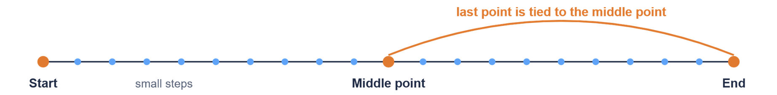
Finite Difference Extension
Our Main Extension: Finite Difference Method
A classical method: cut the problem into many small steps and solve for the answer at every step.
1
2
3
Split into small steps
Link neighbours
Add the three-point condition
Divide the interval from 0 to 1 into many equally spaced points.
Each point is connected to the points next to it, so the problem becomes simple arithmetic.
The end point is tied to the middle point, and all points are solved together.
No training and no random seeds: it gives the same answer every time. We used 400 steps for the main comparison.

Slide 20
1. Split the interval into small steps
My Work
import numpy as np
N = 400
a, b = 0.0, 1.0
h = (b - a) / N
x = np.linspace(a, b, N + 1)
We divide the interval [0,1] into 400 equal subintervals.

Slide 21

2. Link neighbouring points
My Work
for i in range(1, N):
x_prev = x[i - 1]
x_curr = x[i]
x_next = x[i + 1]
# Central difference approximation of y''(x_i)
d2y = (y[i + 1] - 2*y[i] + y[i - 1]) / h**2
  Each interior point is connected to its left and right neighbours.
  We approximate the second derivative using the central difference formula

Slide 22
3. Add the three-point boundary condition
My Work
mid = N // 2
# Illustrative condition only:
# y(1) = y(0.5)
boundary_residual = y[N] - y[mid]
  A three-point boundary value problem has a condition that connects solution values at different locations.
  Here, mid identifies the grid point at the middle of the interval.

Slide 23
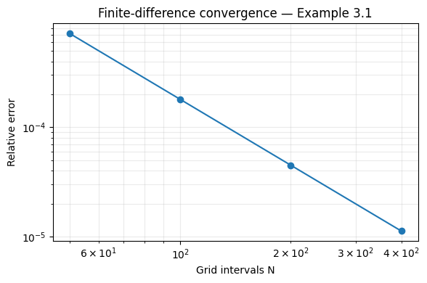
Finite Difference Extension · Convergence
FDM Convergence Study: N = 50 to 400
N | Ex 3.1 RMSE | Ex 3.2 RMSE | Ex 3.3 RMSE
50 | 5.05e-4 | 6.41e-5 | 5.19e-5
100 | 1.27e-4 | 1.81e-5 | 1.28e-5
200 | 3.18e-5 | 4.99e-6 | 3.19e-6
400 | 7.95e-6 | 1.36e-6 | 7.96e-7
Error ratio per halving | ≈ 4.0× | ≈ 3.6× | ≈ 4.0×
  RMSE falls about 4× every time the grid is halved: second-order convergence.
  Example 3.2 converges slightly slower, at about 3.6× per halving.
  Even N = 100 beats the best PINN mean RMSE on all three examples.
  Solve time at N = 400 is 0.006 to 0.018 s.
Relative error vs N, Example 3.1

Slide 24
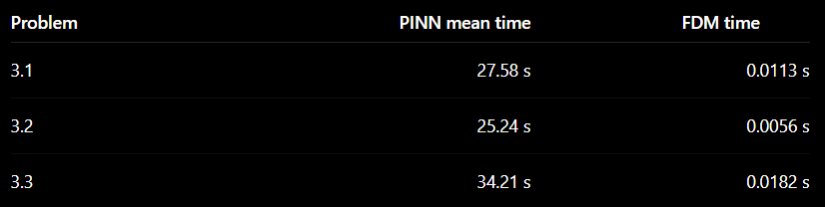
Speed & Convergence
Computational Efficiency & FDM Convergence
FDM becomes more accurate as the grid is refined, demonstrating second-order convergence.

Slide 25
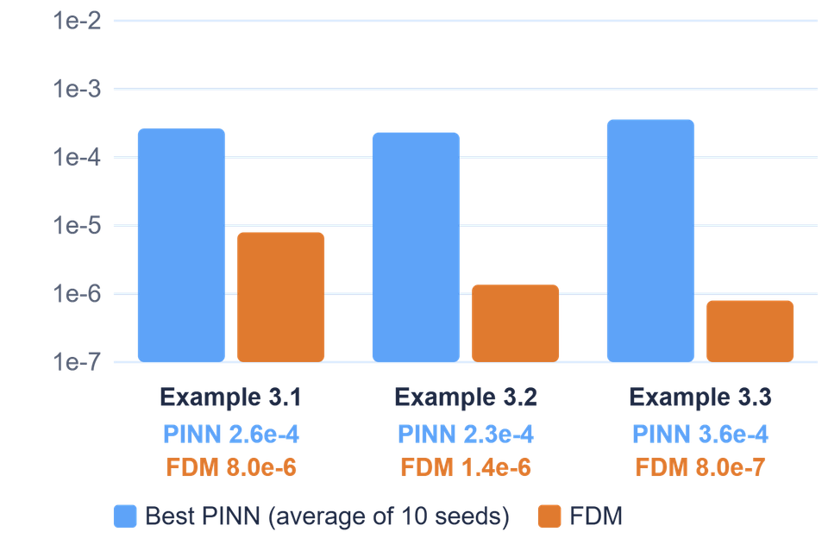
Numerical Solution Comparison
Same Curves, Very Different Errors
33× to 449×
more accurate: FDM error is far smaller on all three examples
About 2,000× to 4,500×
faster: PINN training takes 25 to 34 s, FDM takes under 0.02 s
Seed-dependent
PINN accuracy changes with the random start, so one run can mislead
Error (RMSE): a shorter bar is better. Each gridline is 10× smaller than the one above.
On these smooth one-dimensional problems, the classical method wins on both accuracy and speed. This is a result for our experiments, not a general rule.

Slide 26
Seed Variability
Why 10 Random Seeds Matter
Single seed
Can give a misleading impression of performance.
10 seeds
Shows:
  Mean performance
  Standard deviation
  Best run
  Worst run
  Initialization sensitivity
A single PINN training run is not enough to reliably rank competing configurations.

Slide 27

Contribution
Contributions & Future Work
What we achieved
01 — Reproduction
Reproduced the four PINN approaches from the reference study.
02 — Robustness
Expanded the experiment to 10 random seeds × 10,000 epochs.
03 — Extension
Implemented Finite Difference Method as a classical numerical baseline.
04 — Comparison
Compared PINN and FDM in:
  Accuracy
  RMSE
  Runtime
  Grid convergence

Slide 28
The ending
CONCLUSION
1. Problem Studied: We investigated singular Three-Point Boundary Value Problems (TPS-BVPs), which involve differential equations with boundary conditions specified at three points and singularities within the domain.
2. PINN Implementation: We reproduced four approaches from the reference paper: Standard PINN, PINN with L1 regularization, PINN with L2 regularization, and Adaptive PINN (A-PINN), using three benchmark problems.
3. Training Setup: We trained the models using 500 collocation points, a neural network with three hidden layers and 20 neurons per layer, the tanh activation function, and the Adam optimizer for 10,000 epochs.
4. Robustness Analysis: We repeated the experiments using 10 random seeds, resulting in 120 PINN training runs. This helped us evaluate performance variability and sensitivity to random initialization.
5. FDM Extension: We implemented the Finite Difference Method using second-order central differences and compared grid sizes of N=50,100,200,400 to study accuracy and convergence.
6. Comparative Results: FDM achieved significantly lower RMSE and required much less computational time than the PINN approaches across all three benchmark problems. Among the PINNs, L2 regularization performed best for Examples 3.1 and 3.3, while Standard PINN performed best for Example 3.2.

Slide 29

PINN vs Finite Difference on Singular Three-Point Boundary Value Problems
Thank
You
Presentation By
BATCH-22

